Slide 1
FRONT END ENGINEERING PROJECT-1 topic : countdown to a special event
TEAM DETAILS:
VEDIK(2310990998)
VINAY(2310990999)
“PROJECT GROUP NO. 8
SUBMITTED TO:
DR. GAGANPREET KAUR
CHITKARA UNIVERSITY INSTITUTE OF ENGINEERING AND TECHNOLOGY,
CHITKARA UNIVERSITY, PUNJAB

Slide 2
‘Contents’
INTRODUCTION
TECHNICAL DETAILS
TAGS USED IN PROJECT
KEY FEATURE
PROBLEM STATEMENT
WEBSITE INTERFACE
REFRENCE LINKS USED
COUNTDOWN TIMER
CONCLUSION

Slide 3
introduction
We are thrilled to present our "Own Website" named "FINAL COUNTDOWN". Our team members are Vinay and Vedik. A countdown timer is a digital or mechanical device that counts down a specified amount of time, often displayed in minutes, seconds, or hours, until it reaches zero. It's used to measure and display the remaining time for various purposes.

Slide 4
Technical details:
HTML, CSS & Java are widely used in this project
HTML: It includes various heading tag or unordered list, paragraph heading and button tag alongside many anchor and link tags.
CSS: It includes various designing attributes related to it. Ex: adding colors, Light boxes, borders and making the website user-appealing by using it.
Javascript: Javascript start a timer that decrements count by one every second using the setinterval method.

Slide 5
Tags used
NAVIGATION TAG
ANCHOR TAG
DIVISION TAG
HEADING TAG
PARAGRAPH TAG
BREAK TAG
HEADER TAG

Slide 6
Key features
Final Countdown" can function without an internet connection, allowing users to rely on it in various situations.
-Social Media Integration:
1.Sharing Options: Enable users to easily share their countdown on social media platforms.
2.Hashtags: Encourage the use of event-related hashtags for community building.
-User Engagement:
Interactive Elements: Incorporate interactive elements,such as polls, quizzes, or daily countdown challenges
Notifications: Allow users to subscribe to notifications forimportant updates or milestones leading up to the event.
-"Final Countdown" Allow timers to run in the background, even when the app is closed, so users can multitask while keeping track of time.

Slide 7
Problem statement
The main purpose of a countdown timer is to create a sense of urgency and give the feeling that "time is running out".
Many countdown timer apps offer limited customization options for timer appearance, alert sounds, and notifications. Users have expressed a desire for more personalization features.
Users often lose interest in countdown timers that do not engage them effectively Improving the visual appeal and gamification elements can make timers more appealing.
Many users switch between devices and platforms, such as smartphones, tablets, and computers. Existing timers may not sync seamlessly across these devices or may lack compatibility with different operating systems.

Slide 8
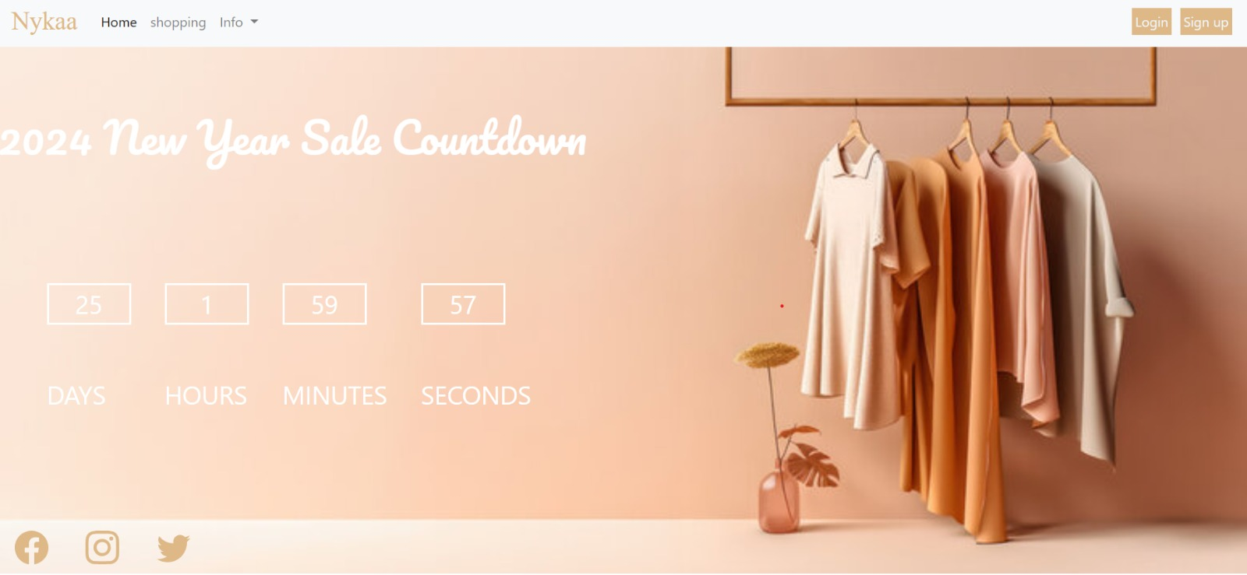

Slide 9
Refrence links
https://youtu.be/6311FJdQvoo?feature=sharedhttps://www.w3schools.com/html/html_css.asp
https://stackoverflow.com/questions/51596004/pure-css-countdown

Slide 10
conclusion
In conclusion, countdown timers are versatile tools that serve a multitude of purposes in both personal and professional contexts. They help individuals manage their time effectively, enhance productivity, and stay organized. The flexibility of countdown timers is further enriched when bonus features are integrated. These features, such as customizable alerts, interval timers, recurring timers, and progress tracking, cater to diverse user needs and preferences. Whether ticking down to the launch of a product, the start of a special occasion, or the end of a work sprint, these timers symbolize the ticking moments that shape our experiences.

Slide 11


